Slide 1

Monitoring SQL Server
Brad M. McGehee
SQL Server MVP
Director of DBA Education
www.bradmcgehee.com
Red Gate Software

Slide 2
What is Monitoring?
Essentially, monitoring is checking up on your servers on a periodic basis to ensure they are healthy and working as expected.
Some things need to be monitored continuously, some hourly, some daily, some weekly, some monthly, etc.
Unfortunately, SQL Server can’t monitor itself very well. As the DBA, this is your job.

Slide 3
Why Monitor SQL Server?
To be a proactive DBA, so that you can:
  Identify and fix small problems before they become big problems.
  Ideally, you will identify and fix problems before your users even know the problems exist.
  Identify problems as soon as they occur in order to keep your users online and productive.
Being a proactive DBA is much less stressful than being a reactive DBA.

Slide 4
What Should You Monitor?
Hardware
Operating System
SQL Server Instance
Database
Overall Server Performance
High Availability

Slide 5
Hardware
Is Physical Hardware Monitored (software is often provided by vendor)
Is I/O Subsystem (DAS, SAN) Monitored
Is Free Disk Space % Monitored
Is Physical Disk Fragmentation Monitored

Slide 6
Operating System Monitoring
Are Hardware Event Logs Monitored
Are System Logs Monitored
Are Application Logs Monitored
Are Security Audit Failures Monitored
Are Other Windows Logs Monitored
Is Virtualization Monitored

Slide 7
SQL Server Instance Monitoring
SQL Server Connectivity
All SQL Server Services
SQL Server Logs
SQL Server Agent Jobs
SQL Server Alerts
Policy Violations (If Using PBM)
Audit Events (Log or SQL Server Audit)

Slide 8
Database Monitoring
Is Database Status Monitored
Are MDF and LDF Sizes Monitored
Is Blocking Monitored
Are Deadlocks Monitored
Is Query Performance Monitored
Are Indexing Needs Monitored
Is Database Corruption Monitored
Is Replication Monitored

Slide 9
Overall Server Performance Monitoring
Is CPU Utilization Monitored
Is Memory Utilization Monitored
Is I/O Utilization Monitored
Is Network Utilization Monitored

Slide 10
High Availability Monitoring
Is Clustering Monitored
Is Database Mirroring Monitored
Is Log Shipping Monitored
Are Database & Log Backups Monitored
Are Offsite Backups Monitored

Slide 11
Best Ways to Monitor
Manually use tools provided with SQL Server.
Download my SQL Server Health Checklist at www.bradmcgehee.com/healthcheck.zip
Create your own monitoring system.
Use a third-party tool, such as SQL Monitor.
As much as possible, follow the principle of “management by exception”.

Slide 12

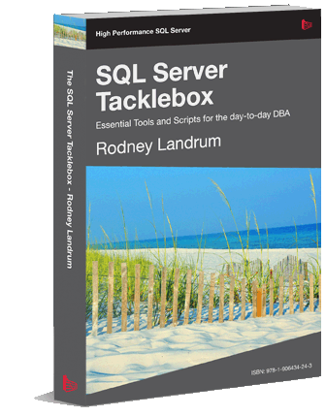
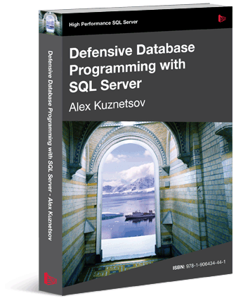

E-books, websites, slides & more
Free E-books on SQL Server:
  www.sqlservercentral.com/Books
Check these websites out:
  www.SQLServerCentral.com
  www.Simple-Talk.com
Blogs:
  www.bradmcgehee.com
  www.twitter.com/bradmcgehee
Contact me at:
  bradmcgehee@hotmail.com

Slide 13


sponsored by

Slide 14
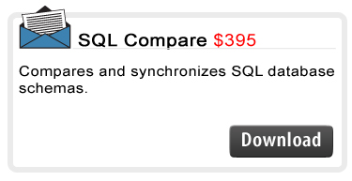
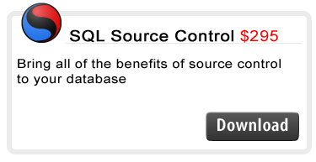
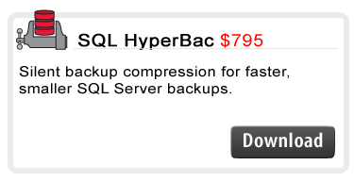
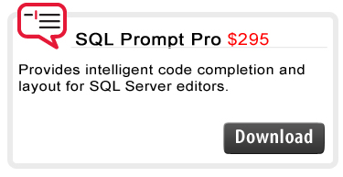
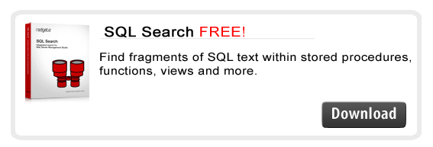
"All the Red Gate products I used are a delight”
Doron Grinstein, Technical Director, Walt Disney

